Slide 1


L’immunothérapie en hématologie.
Un espoir pour les patients, un challenge pour les biologistes
Dr Alain Kentos
Service d’Hématologie
Centres Hospitaliers Jolimont
La Louvière
Belgique

Slide 2
Immunothérapie
Tous les traitements qui encouragent les défenses immunitaires du patient à attaquer le cancer.
L’immunothérapie ne cible donc pas directement les cellules cancéreuses mais collabore avec le système immunitaire afin de les éliminer
https://www.cancer.be/les-cancers/traitements/immunoth-rapie

Slide 3
Cancer
Cellules tumorales
Micro-environnement
Interactions avec le système immunitaire

Slide 4
Immunothérapie
Les cytokines (IFN, IL2, …).
Les anticorps monoclonaux
Les inhibiteurs de checkpoint immunitaire
Les vaccins anticancéreux thérapeutiques
Les bispécifiques
La thérapie cellulaire CAR-T
D’autres immunothérapies (BCG, imiquimod).
https://www.cancer.be/les-cancers/traitements/immunoth-rapie

Slide 5
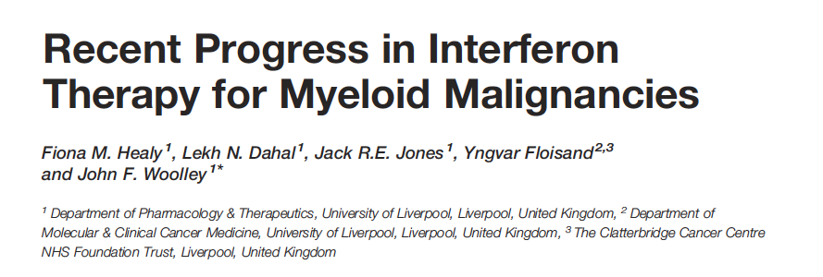
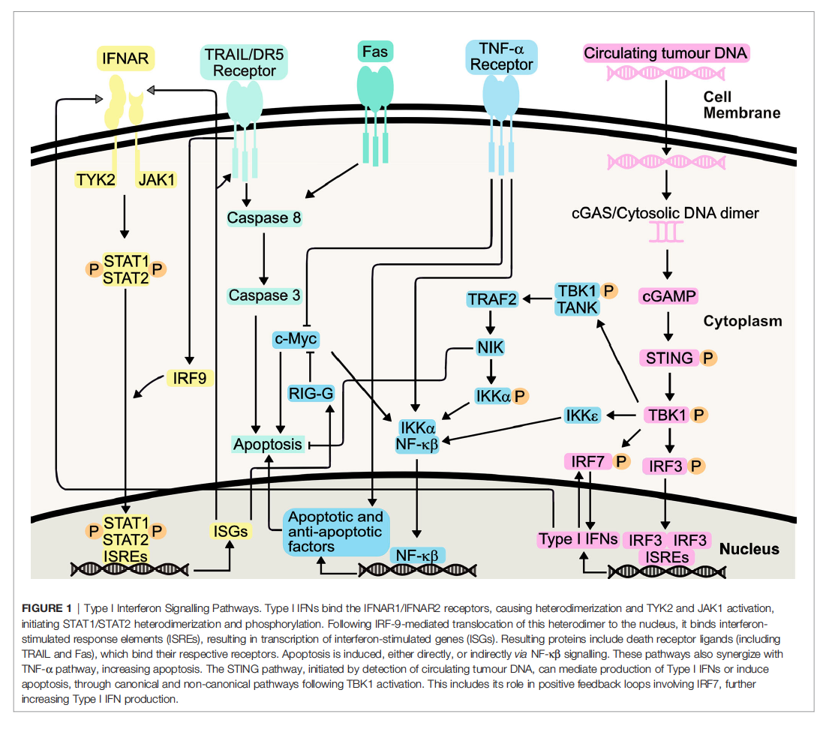
Frontiers in Oncology. 2021;11: article 769228

Slide 6
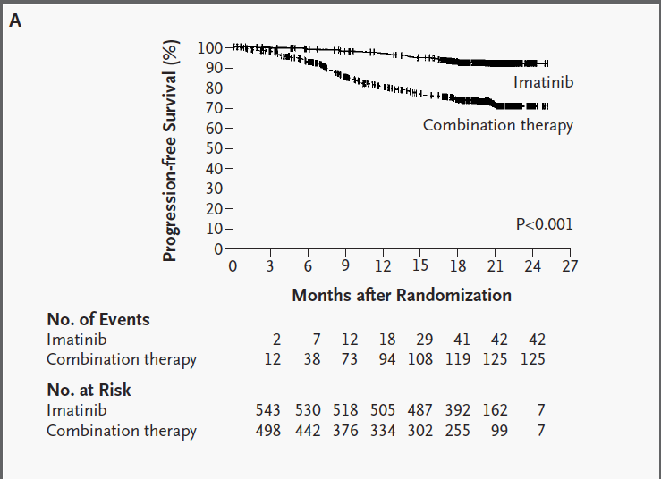
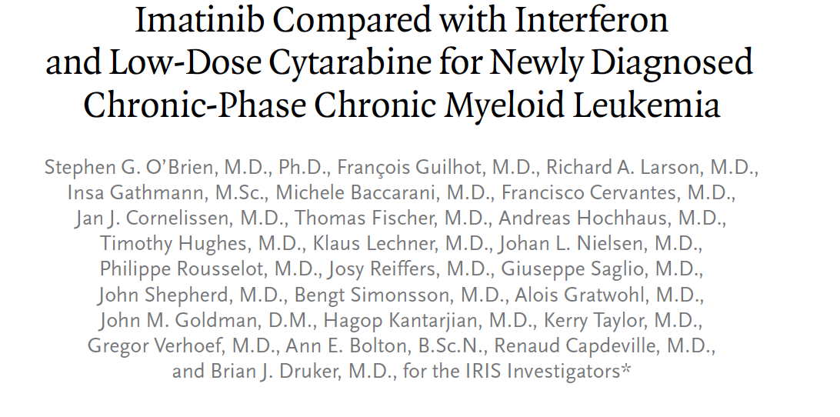

Les cytokines

Slide 7
Immunothérapie
Les cytokines (IFN, IL2, …).
Les anticorps monoclonaux
Les inhibiteurs de checkpoint immunitaire
Les vaccins anticancéreux thérapeutiques
Les BITES
La thérapie cellulaire CAR-T
D’autres immunothérapies (BCG, imiquimod).
https://www.cancer.be/les-cancers/traitements/immunoth-rapie

Slide 8
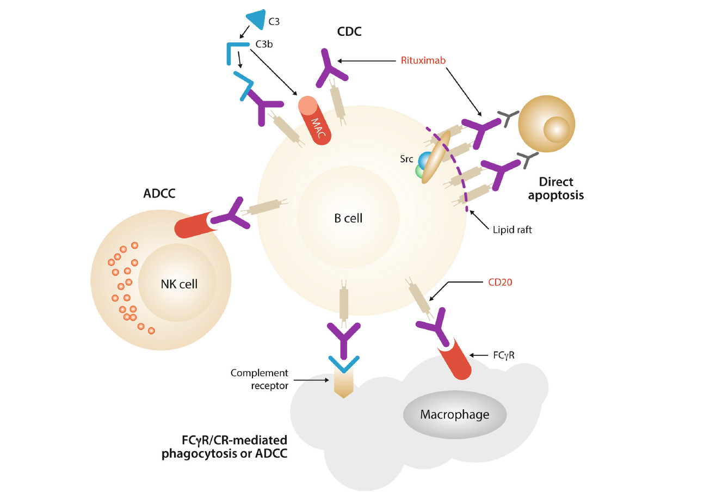

Mécanismes d’action du rituximab
Cytotoxicité induite par le complément
Antibody dependent cytotoxic cytotoxicity
Fc receptor III
MAC = complexe d’attaque membranaire

Slide 9
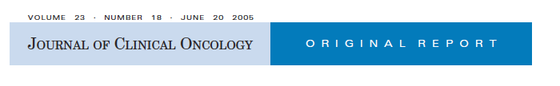
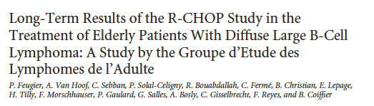
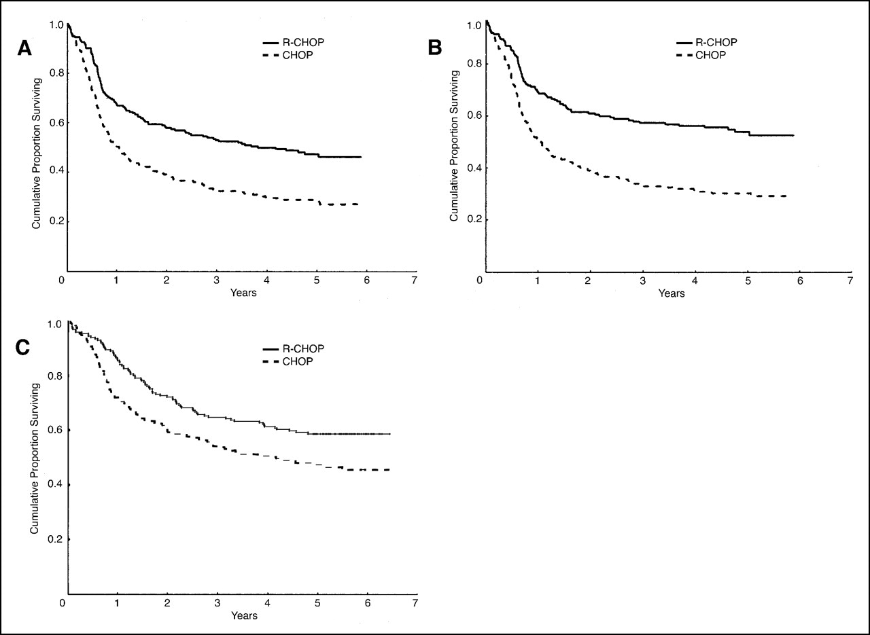
EFS
PFS
OS
Fig 1. (A) Event-free survival, (B) progression-free survival, and (C) overall survival with a median follow-up of 5 years in patients treated with cyclophosphamide, doxorubicin, vincristine, and prednisone (CHOP), and rituximab plus CHOP (R-CHOP). Log-rank test P values are = .00002, < .00001, and = .0073, respectively.

Slide 10
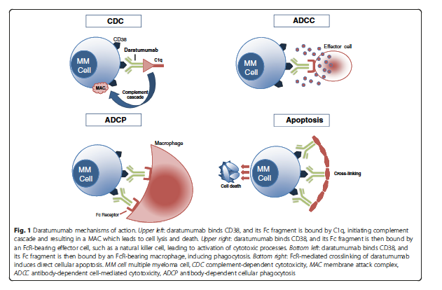

Modes d’action du daratumumab

Slide 11
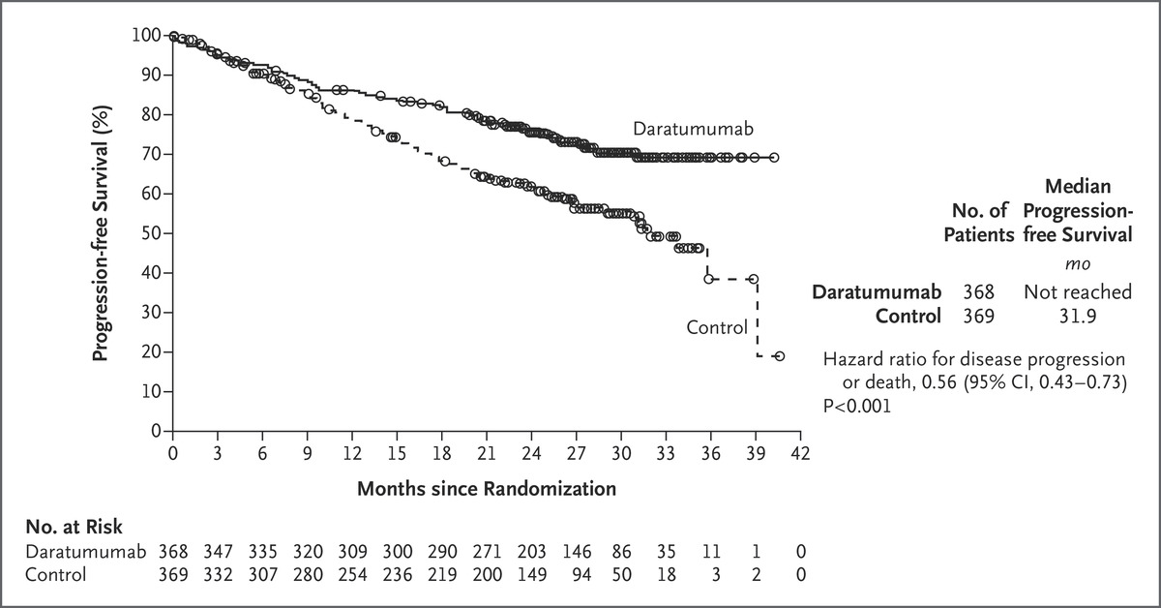

DRD versus RD: PFS
T Facon et al. N Engl J Med 2019;380:2104-2115.
Notes:
Figure 1. Progression-free Survival. Shown are the results of the Kaplan–Meier estimates of progression-free survival among patients in the intention-to-treat population. The daratumumab group received treatment with daratumumab, lenalidomide, and dexamethasone; the control group received treatment with lenalidomide and dexamethasone. The interim analysis of progression-free survival was performed after 240 events of disease progression or death had occurred (62% of the planned 390 events for the final analysis).

Slide 12
Immunothérapie
Les cytokines (IFN, IL2, …).
Les anticorps monoclonaux
Les inhibiteurs de checkpoint immunitaire
Les vaccins anticancéreux thérapeutiques
Les bispécifiques
La thérapie cellulaire CAR-T
D’autres immunothérapies (BCG, imiquimod).
https://www.cancer.be/les-cancers/traitements/immunoth-rapie

Slide 13
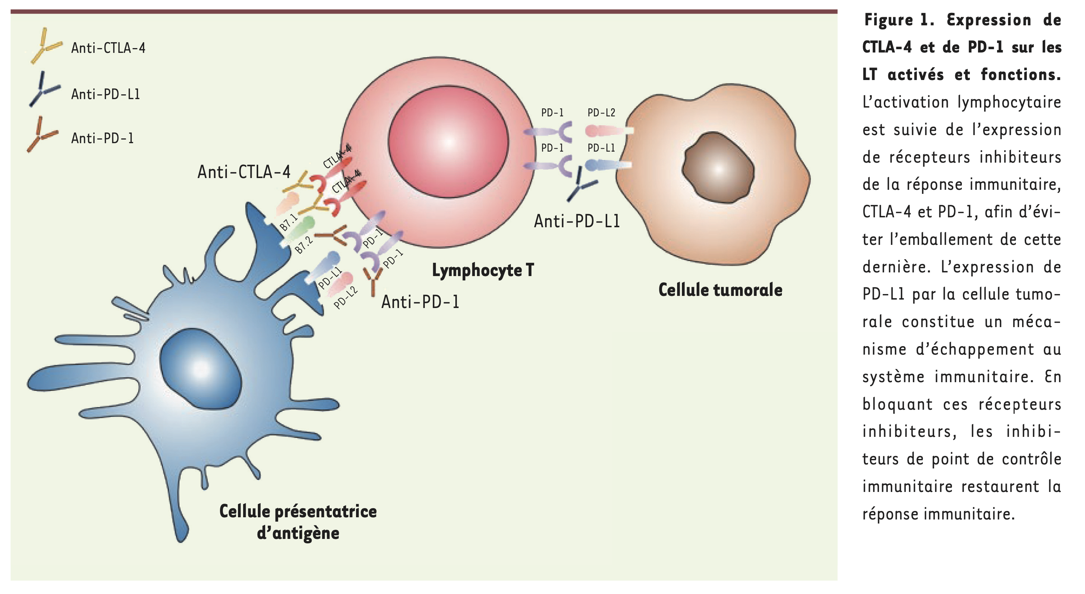
Système PD1 PDL1
diminue prolifération T
diminue production cytokines
diminue la cytotoxicité
rôle crucial dans la balance entre tolérance au soi et autoimmunité
Médecine / sciences 2019;35:937-945

Slide 14
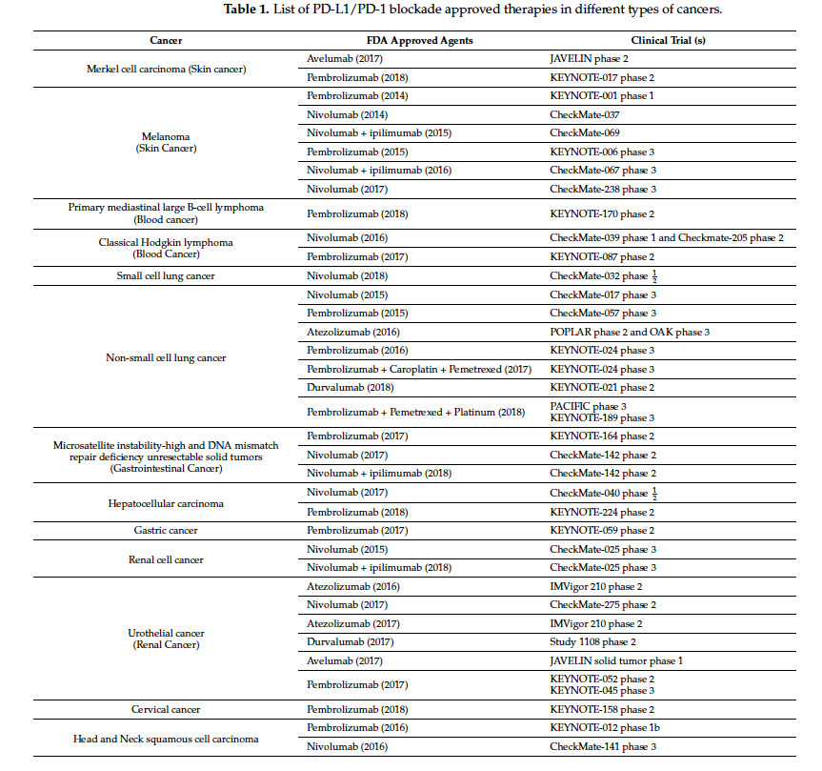
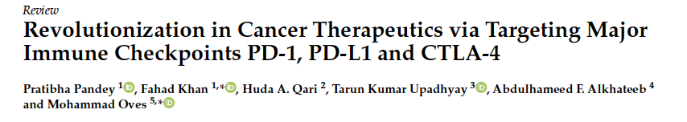
Pharmaceuticals 2022;15:335

Slide 15
Immunothérapie
Les cytokines (IFN, IL2, …).
Les anticorps monoclonaux
Les inhibiteurs de checkpoint immunitaire
(Les vaccins anticancéreux thérapeutiques)
Les bispécifiques
La thérapie cellulaire CAR-T
(D’autres immunothérapies (BCG, imiquimod))
https://www.cancer.be/les-cancers/traitements/immunoth-rapie

Slide 16
Myélome
Rapide rappel
Traitement des patients éligibles à la greffe.
La MRD
Traitement des patients non éligibles à la transplantation.
Traitement des patients en rechute ou réfractaires.
Quelques nouveaux traitements d’intérêt.
10h45: pause café (si je vais très vite et qu’il n’y a pas de questions).

Slide 17
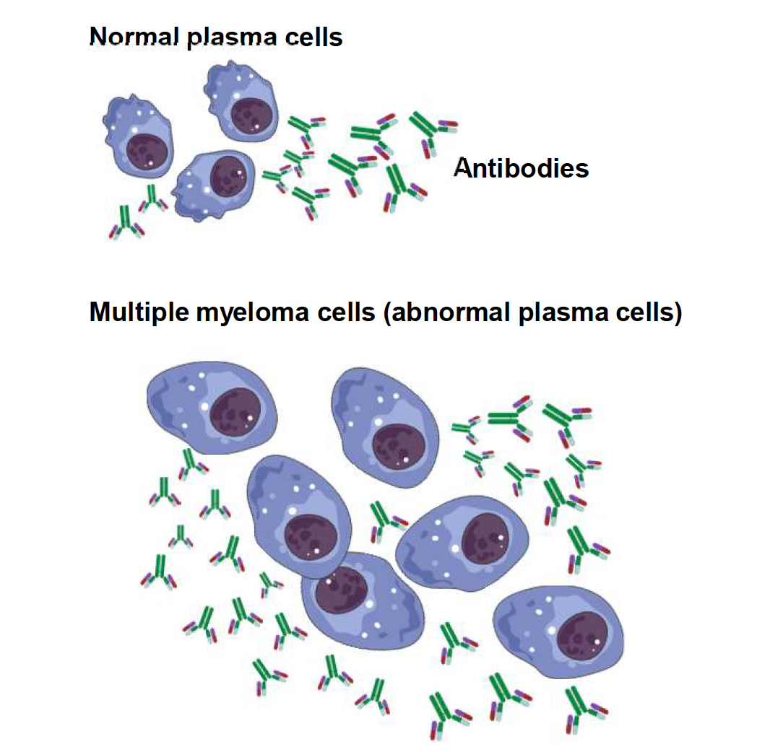
Myélome multiple
Cancer des plasmatocytes de la moelle osseuse qui produisent des anticorps monoclonaux..
1-2% de tous les cancers
Cancer de la personne âgée
  Âge médian au diagnostic: 65-74
  10% < 50 ans

Slide 18
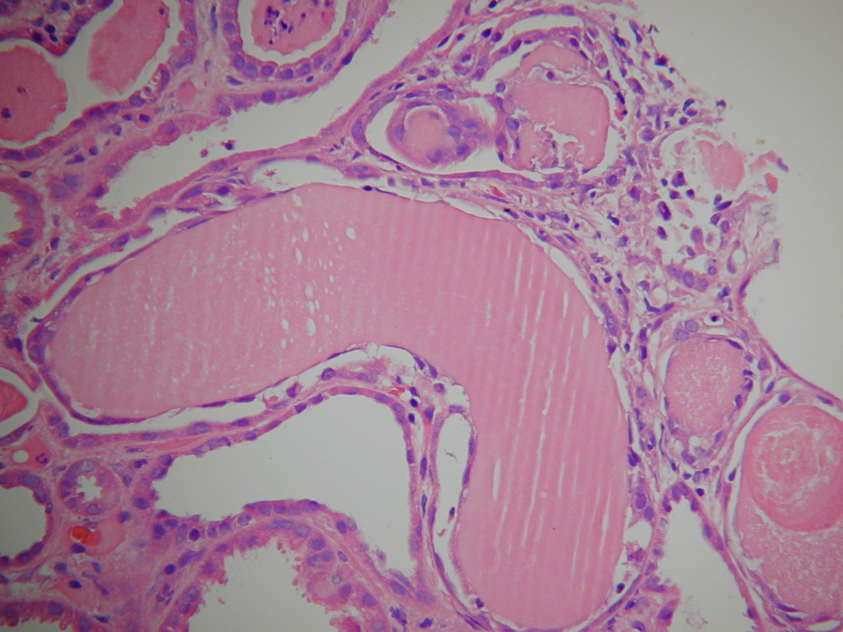
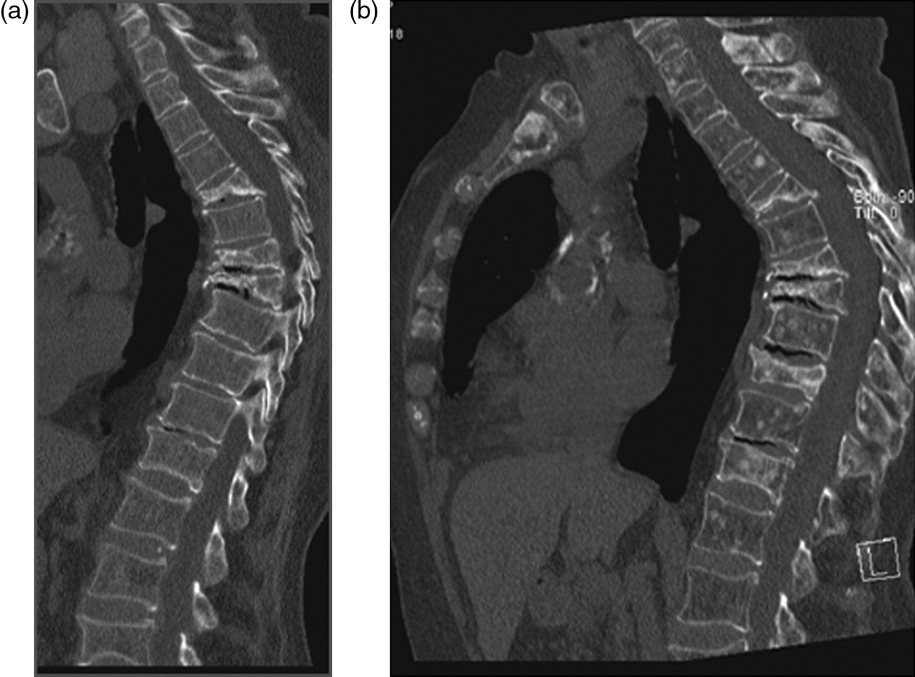
Myélome multiple: manifestations cliniques
Douleurs osseuses
Fatigue/anémie
Insuffisance rénale
Hypercalcémie
Manifestations neurologiques
Infections

Slide 19
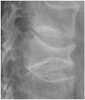
Devastating consequences of myeloma bone disease
Notes:
Treating physicians must keep foremost in mind that myeloma bone disease is often the cause of the most disabling problems that pts face and, therefore, careful baseline and serial radiographic assessments are essential to maintaining and improving their pts quality of life.
Dimopoulos MA et al Leukemia 2009 ‘IMWG consensus statement and guidelines regarding the current role of imaging techniques in the diagnosis and monitoring of multiple myeloma’

Slide 20
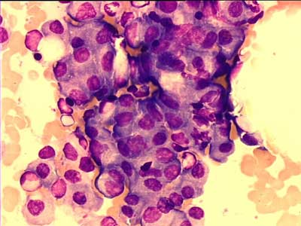
IMWG Criteria for Diagnosis of Multiple Myeloma
MGUS
Smoldering Myeloma
Multiple Myeloma
  M protein < 3 g/dL
  Clonal plasma cells in BM < 10%
  No myeloma-defining events
  M protein ≥ 3 g/dL (serum) or ≥ 500 mg/
  24 hrs (urine)
  Clonal plasma cells in BM ≥ 10% to 60%
  No myeloma-defining events
  Underlying plasma cell proliferative disorder
  AND ≥ 1 myeloma-defining event:
    ≥ 1 CRAB* feature
    Clonal plasma cells in BM ≥ 60%
    Serum free light-chain ratio ≥ 100
  > 1 MRI focal lesion
*C: Calcium elevation (> 11 mg/dL or > 1 mg/dL higher than ULN)
R: Renal insufficiency (CrCl < 40 mL/min or serum creatinine > 2 mg/dL)
A: Anemia (Hb < 10 g/dL or 2 g/dL < normal)
B: Bone disease (≥ 1 lytic lesions on skeletal radiography, CT, or PET/CT)
Rajkumar SV, et al. Lancet Oncol. 2014;15:e538-e548.
Notes:
BM, bone marrow; CrCl, creatinine clearance; Hb, hemoglobin; MGUS, monoclonal gammopathy of undetermined significance; M-protein, monoclonal protein; ULN, upper limit of normal.

Slide 21
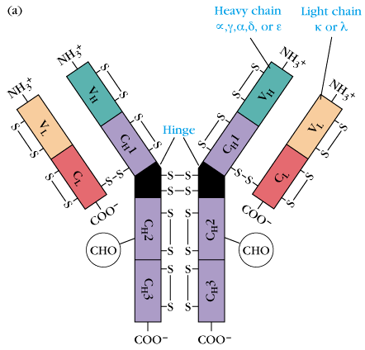
IMWG Criteria for Diagnosis of Multiple Myeloma
MGUS
Smoldering Myeloma
Multiple Myeloma
  M protein < 3 g/dL
  Clonal plasma cells in BM < 10%
  No myeloma-defining events
  M protein ≥ 3 g/dL (serum) or ≥ 500 mg/
  24 hrs (urine)
  Clonal plasma cells in BM ≥ 10% to 60%
  No myeloma-defining events
  Underlying plasma cell proliferative disorder
  AND ≥ 1 myeloma-defining event:
    ≥ 1 CRAB* feature
    Clonal plasma cells in BM ≥ 60%
    Serum free light-chain ratio ≥ 100
  > 1 MRI focal lesion
*C: Calcium elevation (> 11 mg/dL or > 1 mg/dL higher than ULN)
R: Renal insufficiency (CrCl < 40 mL/min or serum creatinine > 2 mg/dL)
A: Anemia (Hb < 10 g/dL or 2 g/dL < normal)
B: Bone disease (≥ 1 lytic lesions on skeletal radiography, CT, or PET/CT)
Rajkumar SV, et al. Lancet Oncol. 2014;15:e538-e548.
Notes:
BM, bone marrow; CrCl, creatinine clearance; Hb, hemoglobin; MGUS, monoclonal gammopathy of undetermined significance; M-protein, monoclonal protein; ULN, upper limit of normal.

Slide 22
IMWG Criteria for Diagnosis of Multiple Myeloma
MGUS
Smoldering Myeloma
Multiple Myeloma
  M protein < 3 g/dL
  Clonal plasma cells in BM < 10%
  No myeloma-defining events
  M protein ≥ 3 g/dL (serum) or ≥ 500 mg/
  24 hrs (urine)
  Clonal plasma cells in BM ≥ 10% to 60%
  No myeloma-defining events
  Underlying plasma cell proliferative disorder
  AND ≥ 1 myeloma-defining event:
    ≥ 1 CRAB* feature
    Clonal plasma cells in BM ≥ 60%
    Serum free light-chain ratio ≥ 100
  > 1 MRI focal lesion
*C: Calcium elevation (> 11 mg/dL or > 1 mg/dL higher than ULN)
R: Renal insufficiency (CrCl < 40 mL/min or serum creatinine > 2 mg/dL)
A: Anemia (Hb < 10 g/dL or 2 g/dL < normal)
B: Bone disease (≥ 1 lytic lesions on skeletal radiography, CT, or PET/CT)
Rajkumar SV, et al. Lancet Oncol. 2014;15:e538-e548.
Notes:
BM, bone marrow; CrCl, creatinine clearance; Hb, hemoglobin; MGUS, monoclonal gammopathy of undetermined significance; M-protein, monoclonal protein; ULN, upper limit of normal.

Slide 23

Myélome multiple: évolution de la prise en charge
Ancienne attitude
Maladie définie par des symptomes et signes (anémie, hypercalcémie, lésions osseuses, insuffisance rénale)
Nouvelle attitude
Maladie définie par des symptomes et des marqueurs
Traitements plus efficaces et moins toxiques
Tests plus sophistiqués pouvant détecter plus tôt la maladie
Permet d’intervenir plus précocément chez certains patients avant que les dégats d’organe (CRAB) ne surviennent.
Rajkumar et al Lancet Oncology 2014;15:e538-e548

Slide 24
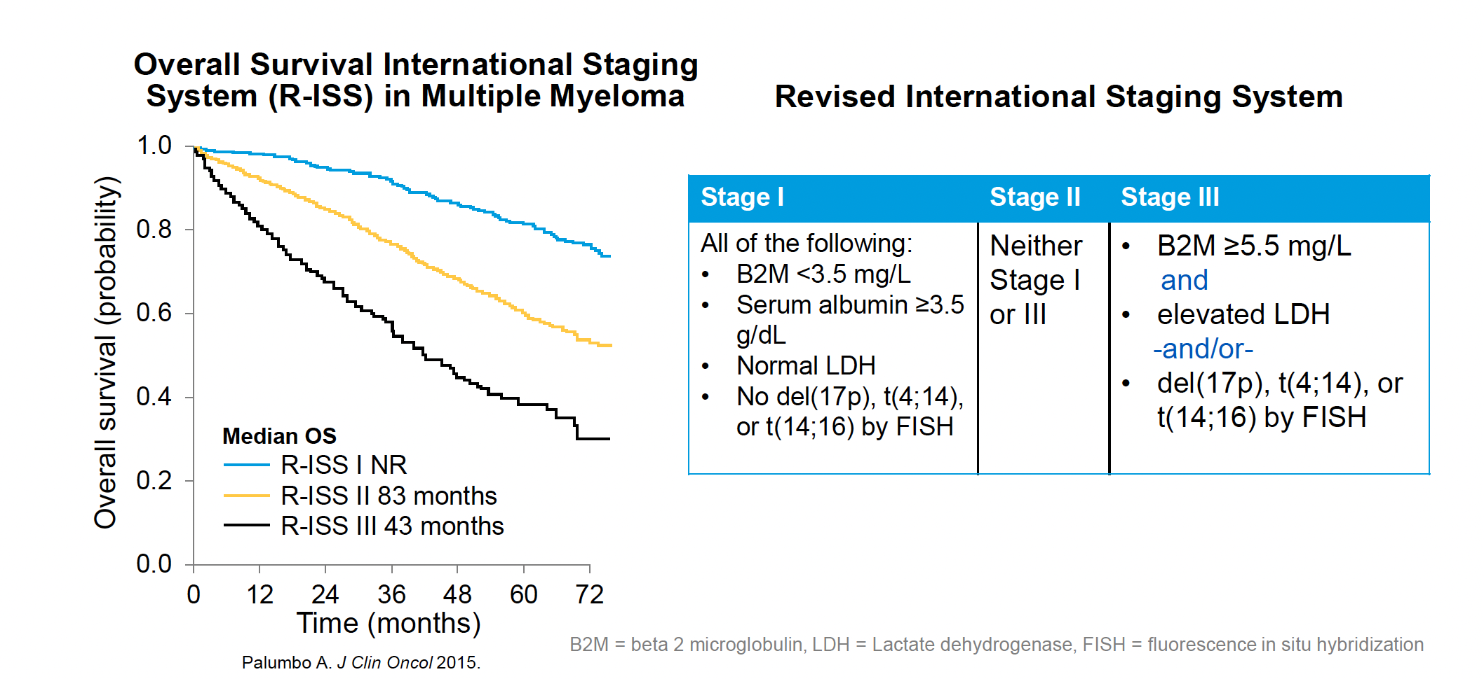
Myélomes multiples.
Maladie très hétérogène.
Pronostic très variable.
Survie de quelques semaines à > 15 ans.

Slide 25
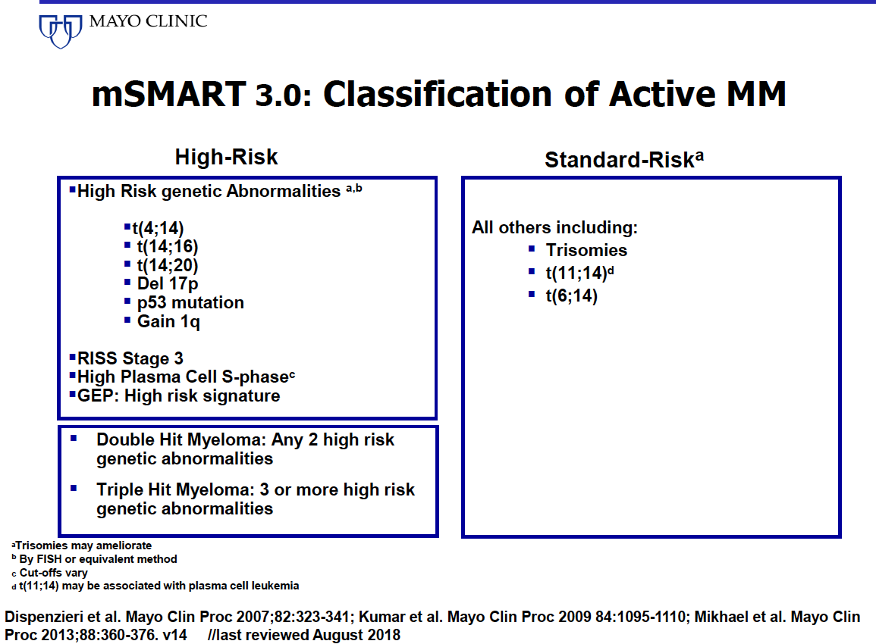
25%
75%

Slide 26
A high-risk, double hit, group of newly diagnosed myeloma identified by genomic analysis
Walker et al. Leukemia 2018
ISS 3 + Bi-allelic TP 53 inactivation or amplification (>4 copies) of CKS1B (1q21)

Slide 27
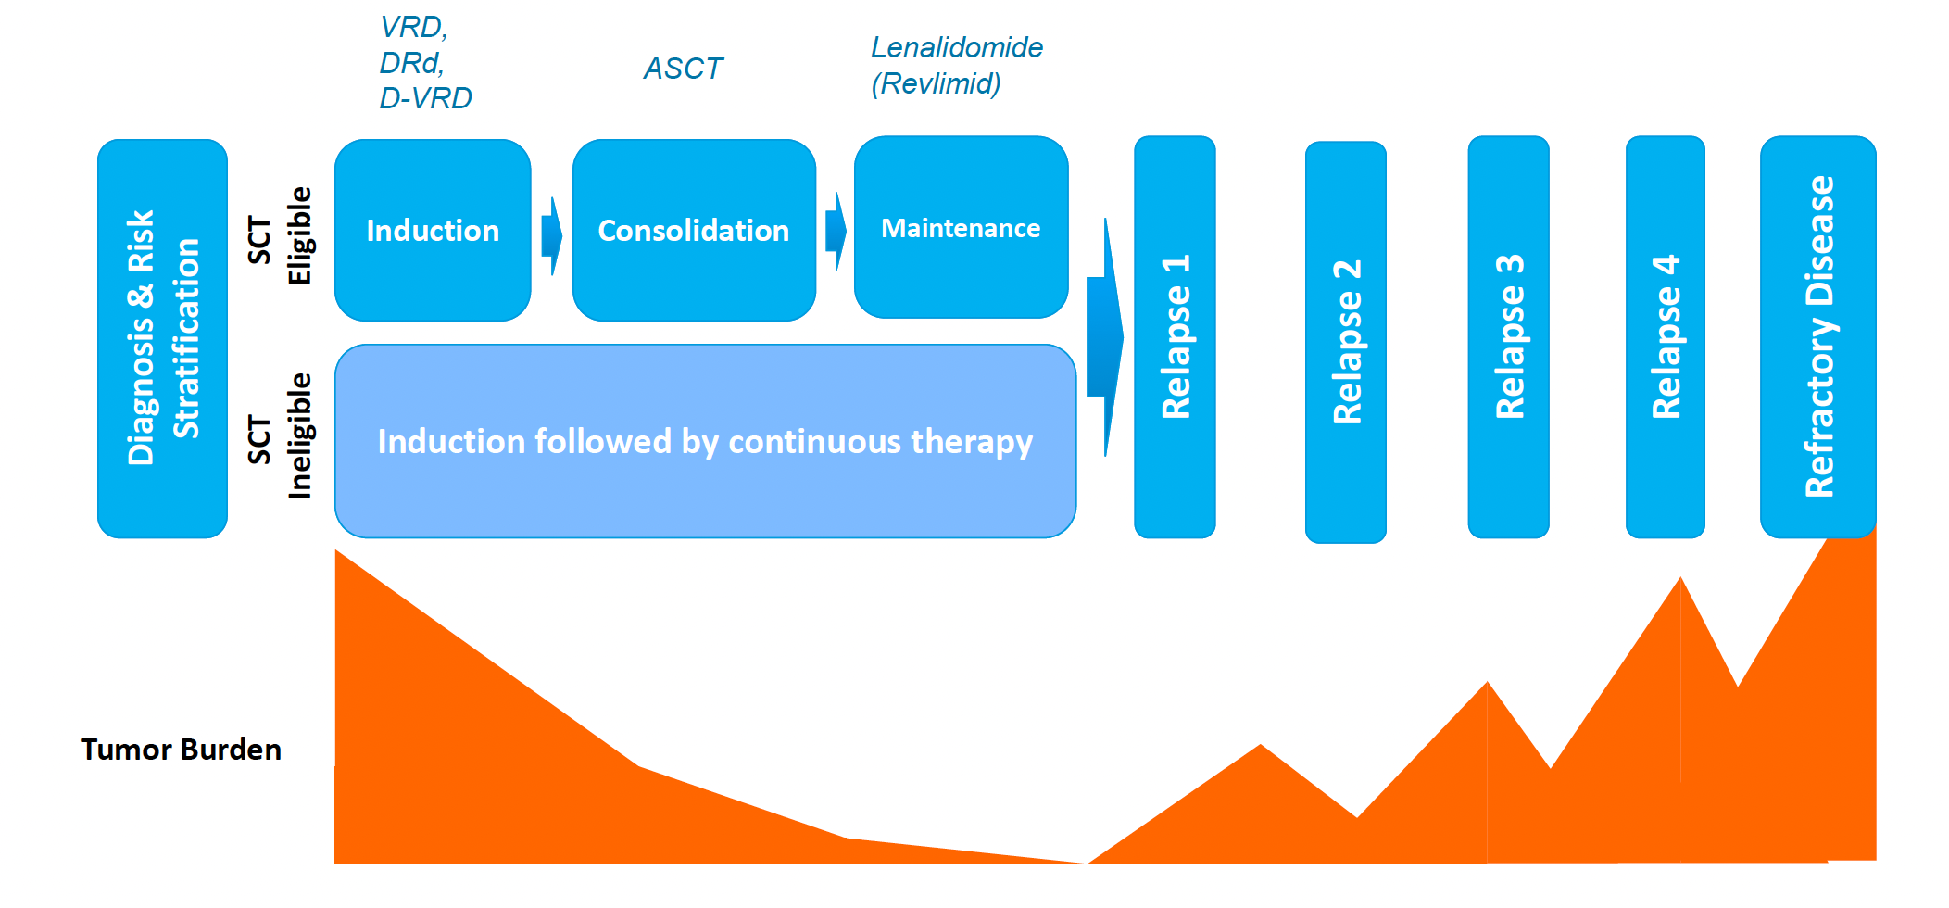
Principe de traitement.

Slide 28
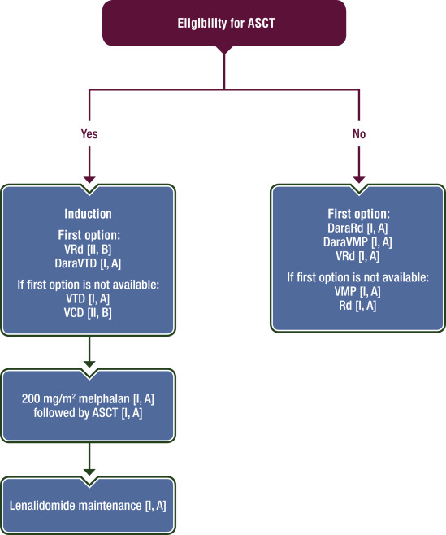
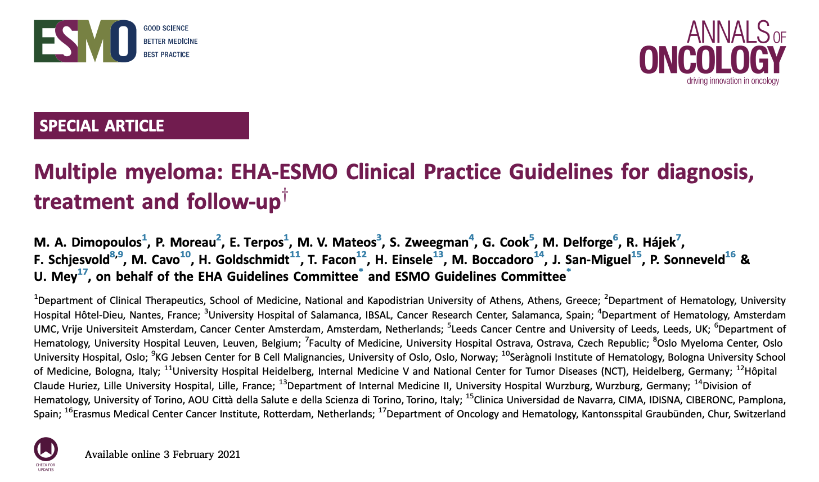
Traitement de première ligne

Slide 29
Phase III IFM/DFCI 2009: VRd ± ASCT in Newly Diagnosed Myeloma
MRD
MRD
VRd*†
8 cycles
*
*
Pts 65 yrs of age or younger with symptomatic NDMM
(N = 700)
Lenalidomide
maintenance
12 mos
VRd*
3 cycles
MEL200
ASCT†
VRd*
2 cycles
consolidation
PR:
20%
VGPR:
29%
*VRd: bortezomib 1.3 mg/m² IV on Days 1, 4, 8, 11 + lenalidomide 25 mg on Days 1-14 + dexamethasone 40 mg on Days 1, 8, 15.
†Included PBSC collection with cyclophosphamide 3 g/m² + G-CSF after cycle 3.
Primary objective: PFS
Secondary objectives: ORR, MRD, TTP, OS, safety
CR:
49%
CR:
59%
Avet-Loiseau H, et al. ASH 2015. Abstract 191. Attal M, et al. ASH 2015. Abstract 391.
Notes:
ASCT, autologous stem cell transplantation; FCM, flow cytometry; MEL200, melphalan 200 mg/m²; MRD, minimal residual disease; NDMM, newly diagnosed multiple myeloma; NGS, next-generation sequencing; TTP, time to progression; VRd, bortezomib, lenalidomide, dexamethasone; VGPR, very good PR.

Slide 30
Phase III IFM/DFCI 2009: Frontline VRd ± ASCT in Younger Pts With MM
Previously untreated patients ≤ 65 yrs of age (N = 700)
PFS benefit in ASCT arm uniform across subgroups: age (< 60 or 60-65 yrs), sex, isotype (IgG or IgA or light chain), ISS stage (I or II or III), cytogenetics (standard or high risk)
Outcome | VRd + ASCT (n = 350) | VRd Only (n = 350) | HR (95% CI) | P Value
Median PFS, mos | 50 | 36 | 0.65 (0.53-0.80) | < .001
4-yr OS, % | 81 | 82 | 1.16 (0.80-1.680 | .87
≥ 1 SPM, % | 7 | 6
ORR, % | 98 | 97
≥ VGPR, % | 88 | 77 |  | .001
Attal. N Engl J Med. 2017;376:1311.
Notes:
ASCT, autologous stem cell transplantation; ISS, International Staging System; MM, multiple myeloma; SPM, secondary primary malignancy; VRd, bortezomib/lenalidomide/dexamethasone.

Slide 31
Phase III IFM/DFCI 2009: VRd ± ASCT in Newly Diagnosed Myeloma
PFS
OS
100
100
ASCT (n = 350)
No ASCT (n = 350)
80
80
60
60
ASCT
No ASCT
Pts (%)
40
40
P < .001
P = NS
20
20
0
0
0
12
24
36
48
0
12
24
36
48
Follow-up (Mos)
Follow-up (Mos)
Attal M, et al. ASH 2015. Abstract 391.
Notes:
ASCT, autologous stem cell transplantation; VRd, bortezomib, lenalidomide, dexamethasone.

Slide 32
Achieving ≥ VGPR or CR was the Goal of Therapy
Achieving ≥ VGPR^{[1]}
Achieving CR^{[2]}
1.00
1.0
0.75
0.8
0.6
0.50
Probability of OS
Probability of OS
P = .0017
0.4
0.25
CR + VGPR (n = 445)
0.2
PR (n = 288)
CR or better
PR
PD
VGPR
SD
0
0
0
1
2
3
4
5
6
7
8
0
1
2
3
4
5
6
7
Yrs Since Transplantation
Yrs Since Transplantation
Significantly better 5-yr OS in patients with sCR (80%) vs CR (53%) or nCR (47%) (P < .001)
1. Harousseau JL, et al. J Clin Oncol. 2009;27:5720-5726.
2. Kapoor P, et al. J Clin Oncol. 2013;31:4529-4535.
Notes:
nCR, near CR; PD, progressive disease; sCR, stringent CR; SD, stable disease.
32

Slide 33
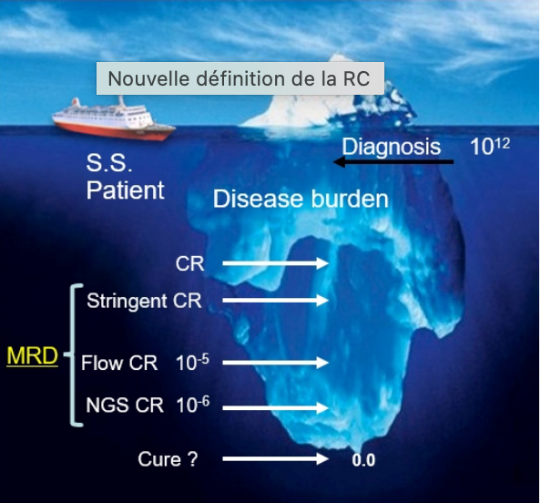
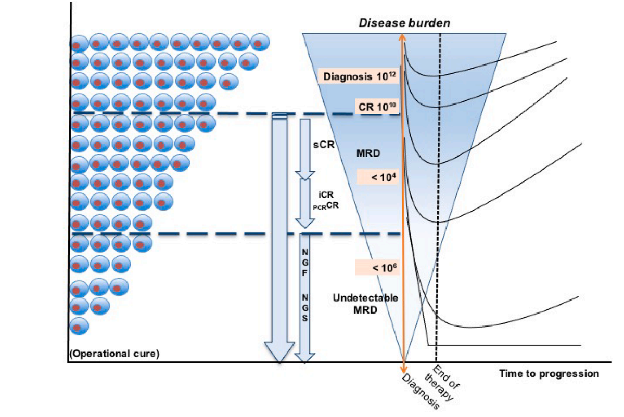
Importance de la maladie résiduelle

Slide 34
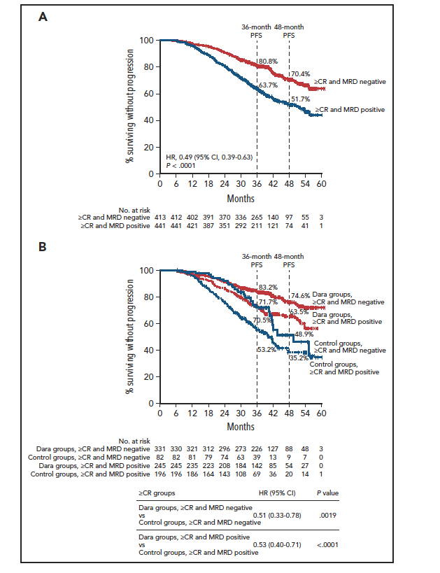
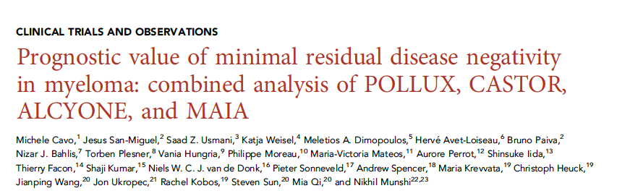
Blood 2022;139:834-844

Slide 35
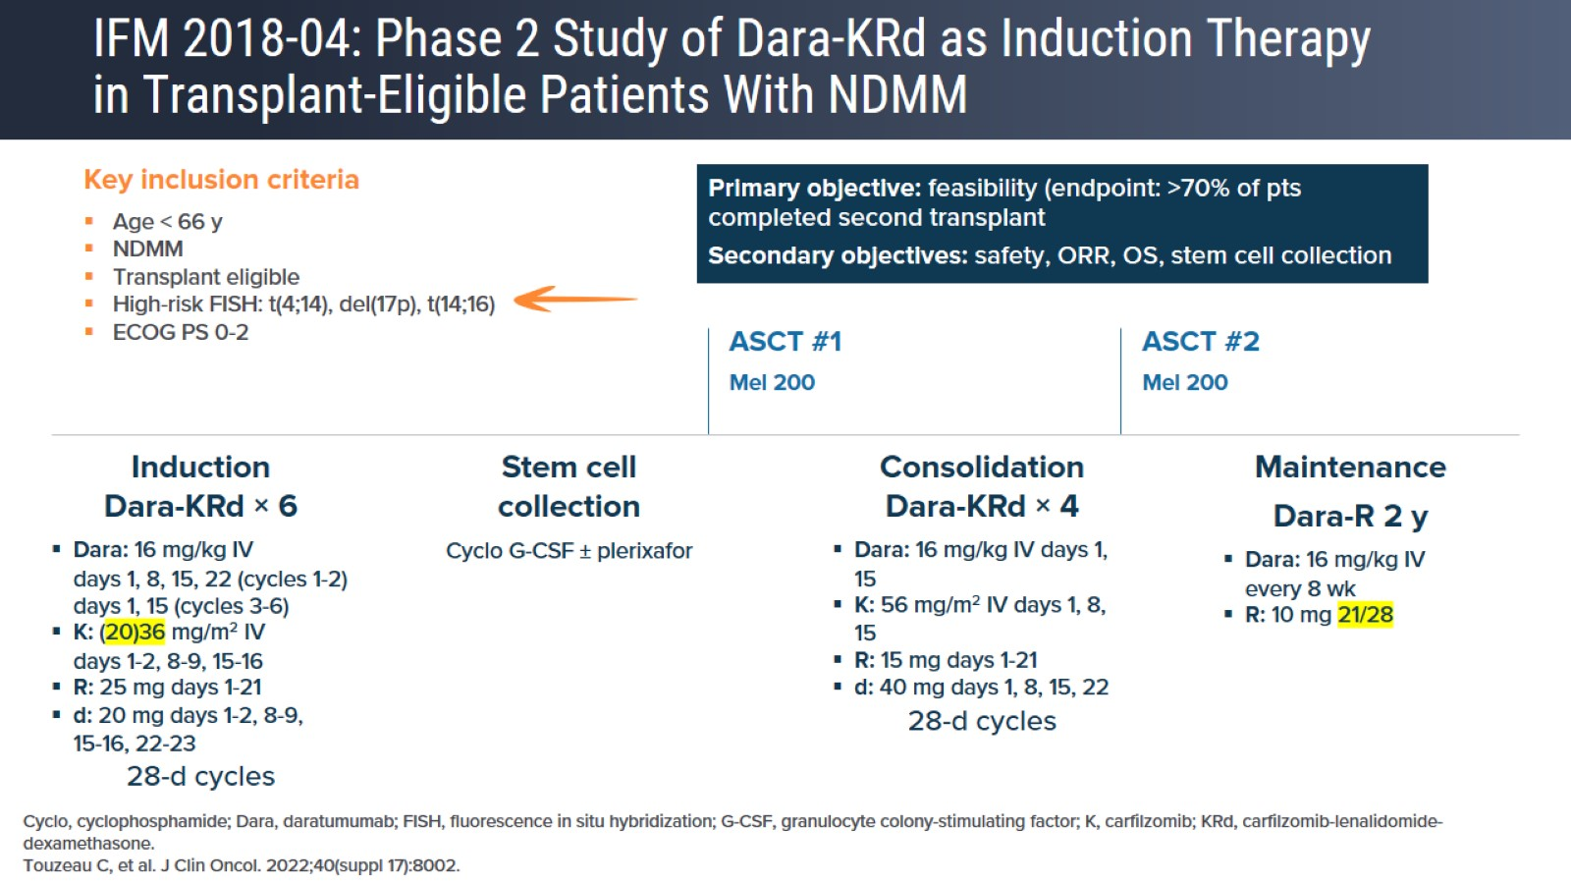
IFM 2018-04: Phase 2 Study of Dara-KRd as Induction Therapy in Transplant-Eligible Patients With NDMM

Slide 36
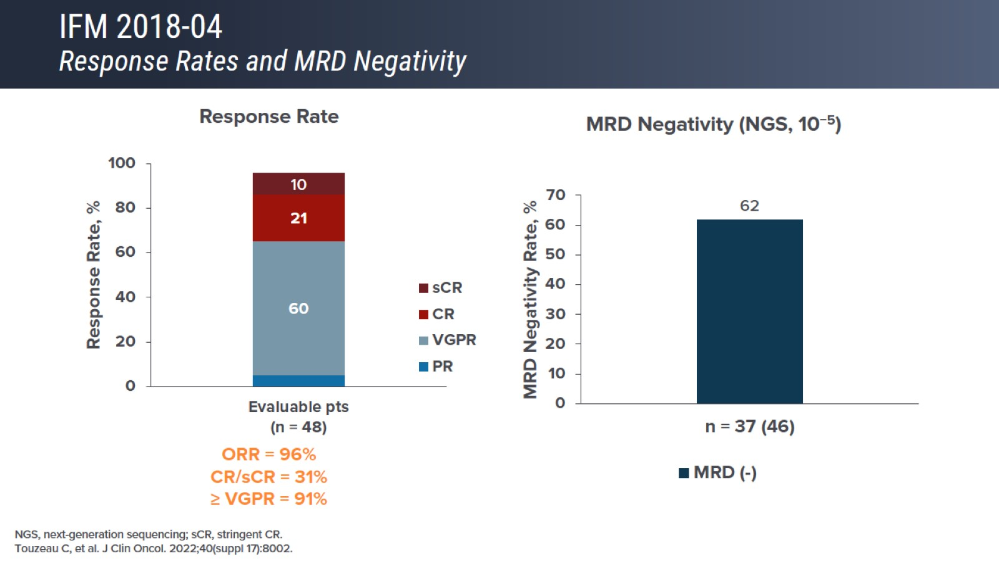
IFM 2018-04
Response Rates and MRD Negativity

Slide 37
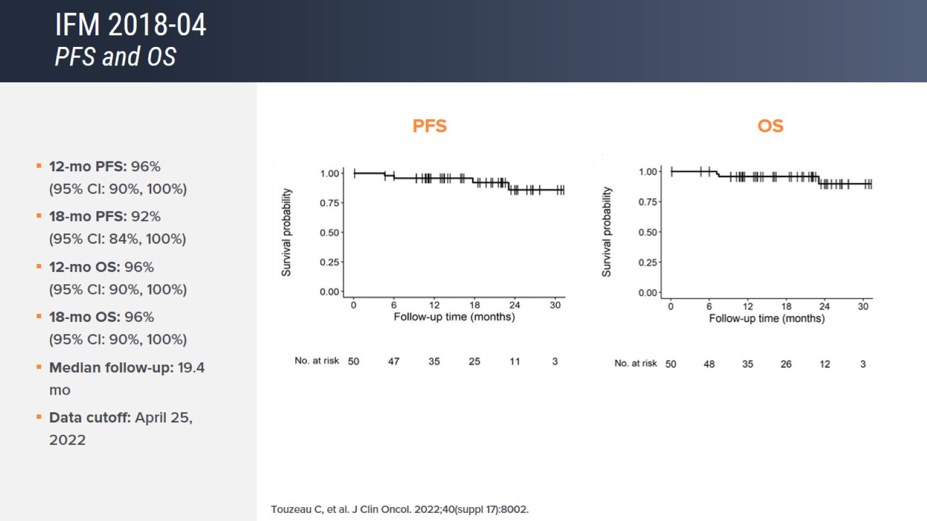
IFM 2018-04
PFS and OS

Slide 38
Single vs Double ASCT: Analysis of 3 Studies
Kaplan-Meier PFS Estimates
Kaplan-Meier OS Estimates
1.00
1.00
2 ASCT
75%
0.75
0.75
2 ASCT
0.50
0.50
1 ASCT
Percentage of Pts
63%
0.25
1 ASCT
0.25
Log-rank test
P = .0005
HR: 0.72
(95% CI: 0.60-0.87; P < .001)
Log-rank test
P = .0021
HR: 0.65
(95% CI: 0.50-0.86; P = .002)
0
0
0
12
24
36
48
60
0
12
24
36
48
60
Mos
Mos
Compilation of European phase III studies
Median PFS: 2 ASCT, 50 mos; 1 ASCT, 38 mos
Maximum benefit in pts with high-risk disease, especially del(17p) and t(4;14)
Cavo M, et al. ASH 2013. Abstract 767.
Notes:
ASCT, autologous stem cell transplantation.

Slide 39
Traitement de première ligne

Slide 40
Lenalidomide Maintenance After ASCT in Myeloma Improves OS (Meta-analysis)
Trials: IFM 2005-02, CALGB 100104, GIMEMA RV-209 (N = 1209)
Treatment: lenalidomide maintenance (n = 605) vs placebo or no maintenance (n = 604)
At median follow-up of 80 mos, 26% ↓ in risk of death and 2.5-yr ↑ in median OS
1.0
7-yr OS
OS, % | Lenalidomide | Control | P Value
OS at 5 yrs | 71 | 66 | .001
OS at 6 yrs | 65 | 58 | .001
OS at 7 yrs | 62 | 50 | .001
0.8
Lenalidomide
62%
0.6
Probability of OS
50%
Control
0.4
N = 1209
Lenalidomide
Control
Median OS,
mos (95% CI)
NE
(NE-NE)
86.0
(79.8-96.0)
0.2
HR (95% CI)
P value
0.74 (0.62-0.89)
.001
Risk of secondary primary malignancy post-ASCT higher in lenalidomide group (HR: 2.03; 95% CI: 1.14-3.61)
0
0
10
20
30
40
50
60
70
80
90
100
110
120
Pts at Risk, n
Mos
Lenalidomide
605
604
578
569
555
542
509
505
474
458
431
425
385
350
282
271
200
174
95
71
20
10
1
0
0
Control
Attal M, et al. ASCO 2016. Abstract 8001.
Notes:
ASCT, autologous stem cell transplantation; NE, not estimable.
Compared with placebo or no maintenance therapy, maintenance therapy with lenalidomide lengthened overall survival (OS) for patients with multiple myeloma (MM) who had undergone autologous hematopoietic cell transplantation (AHCT).
Trials were included in the analysis if they had patient-level data available, used a control arm, and analyzed efficacy in patients with newly diagnosed MM. Three trials met inclusion criteria:
IFM 2005-02: a phase III, double-blind, multi-center trial that compared lenalidomide (10 mg/day for 3 months, increased to 15 mg/day if tolerated) with placebo in patients <65 years
CALGB 100104: a phase III, double-blind trial that compared lenalidomide (10 mg/day) with placebo in patients <71 years
GIMEMA RV-209: a phase III, open-label, multi-center trial that compared high-dose melphalan (200 mg/m²) with a combination of melphalan, prednisone, and lenalidomide (10 mg/day given 21 days in every 28-day cycle) in patients <65 years
Note: they observed significant differences across trials on a heterogeneity test (p=0.047). The heterogeneity could be explained by different induction regimens and pre-transplant consolidation therapies used in the individual trials, or differences in types and frequency of second-line therapies

Slide 41
Not in ISS stage 3
Not in high risk cytogenetics
Management of these patients remains an area of little evidence that needs further study

Slide 42
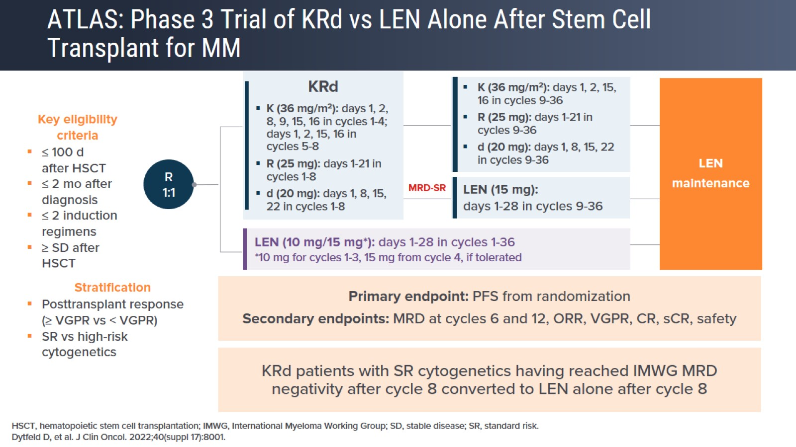
ATLAS: Phase 3 Trial of KRd vs LEN Alone After Stem Cell Transplant for MM

Slide 43
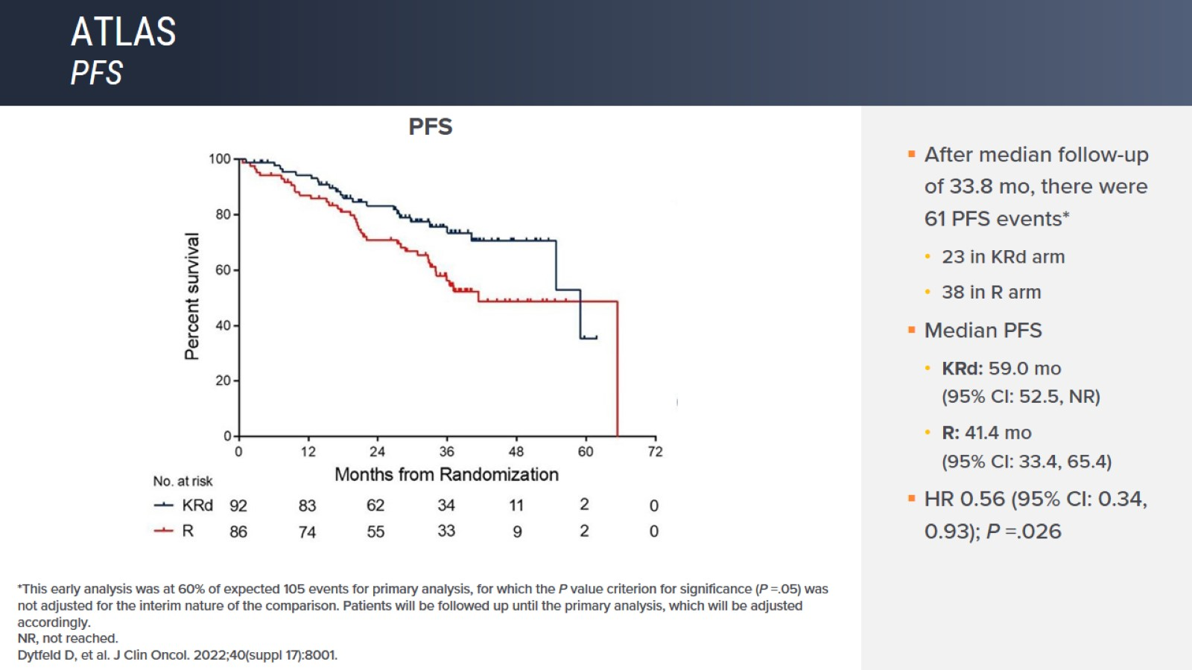
ATLAS
PFS

Slide 44
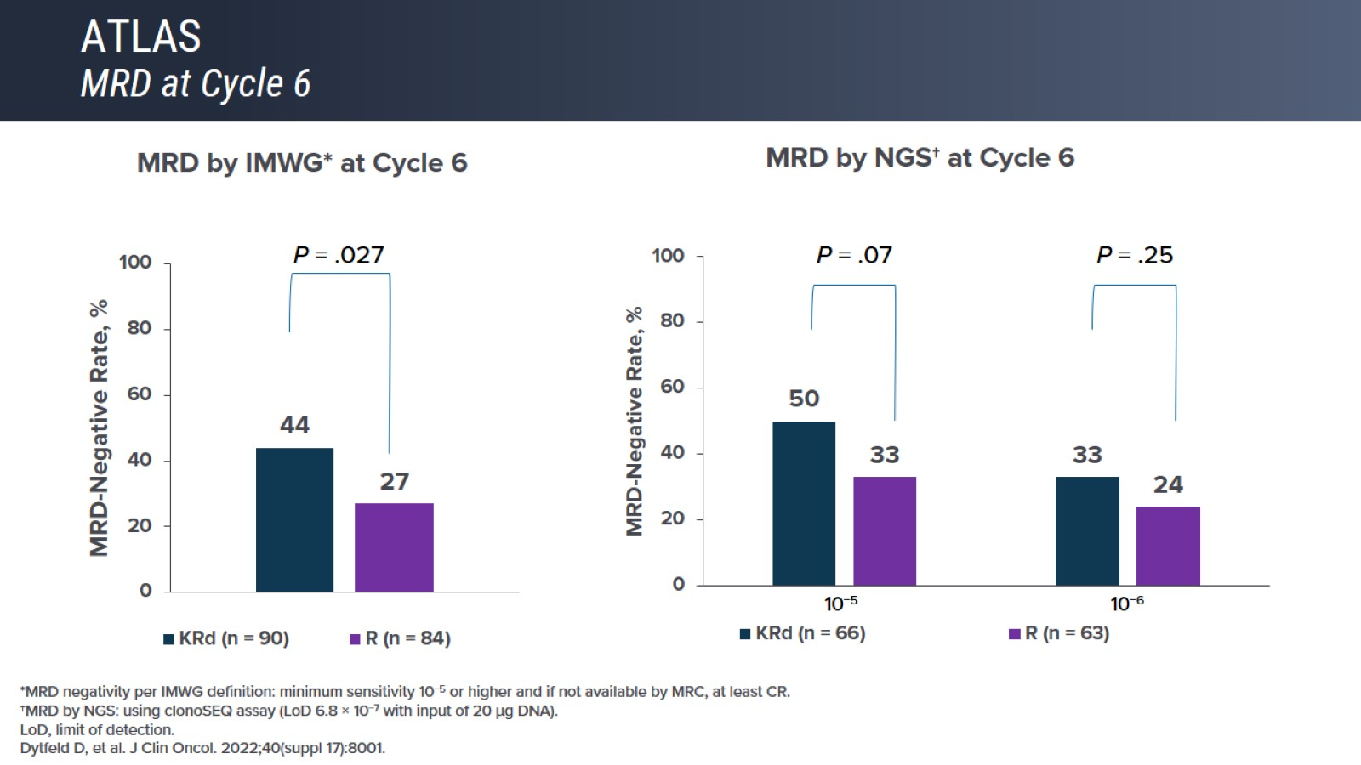
ATLAS
MRD at Cycle 6

Slide 45
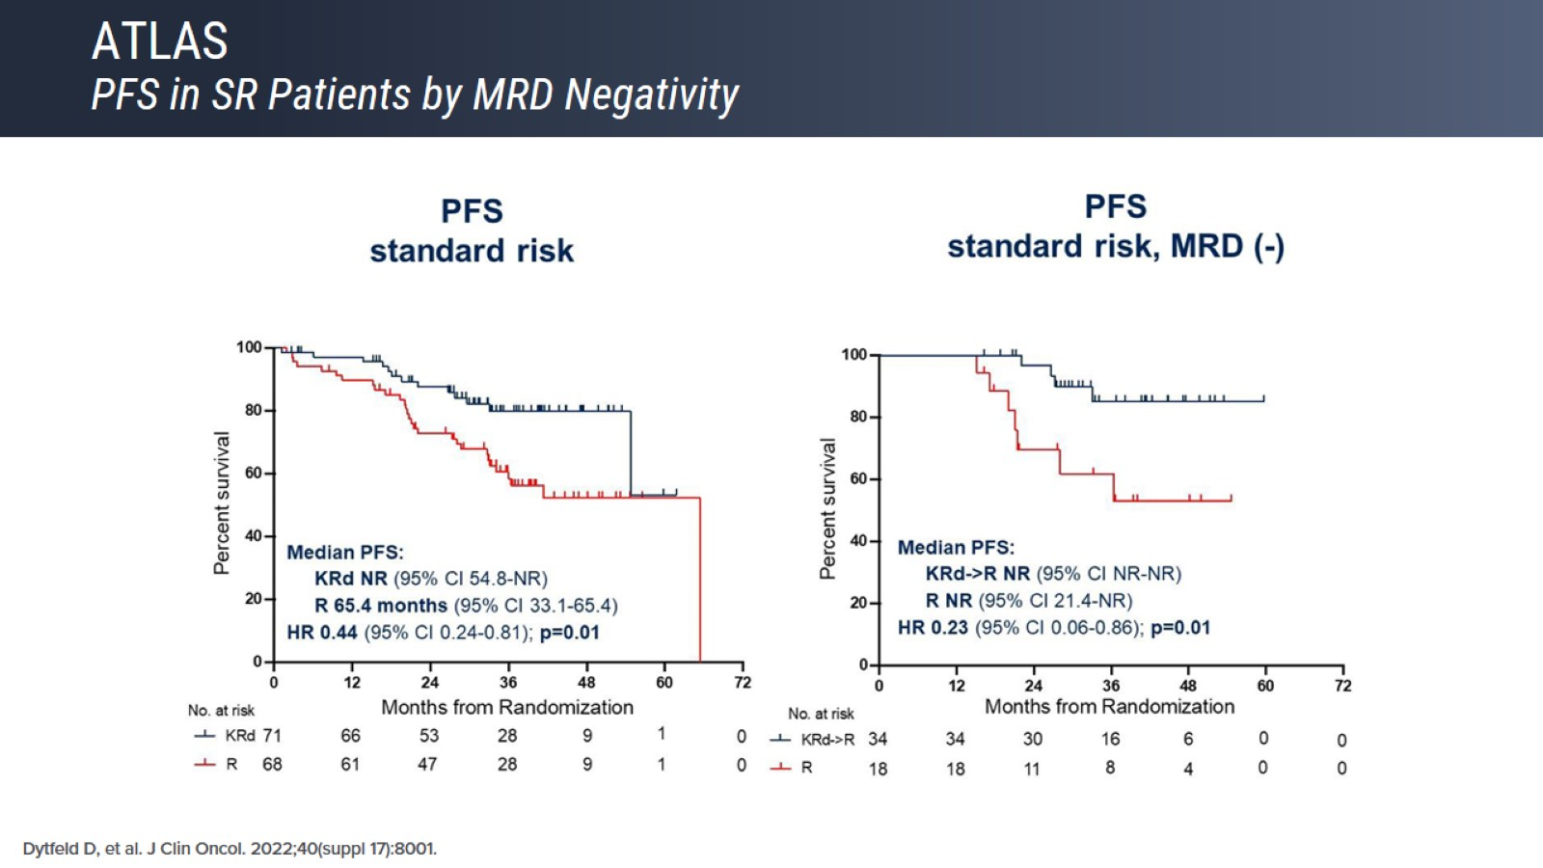
ATLAS
PFS in SR Patients by MRD Negativity

Slide 46
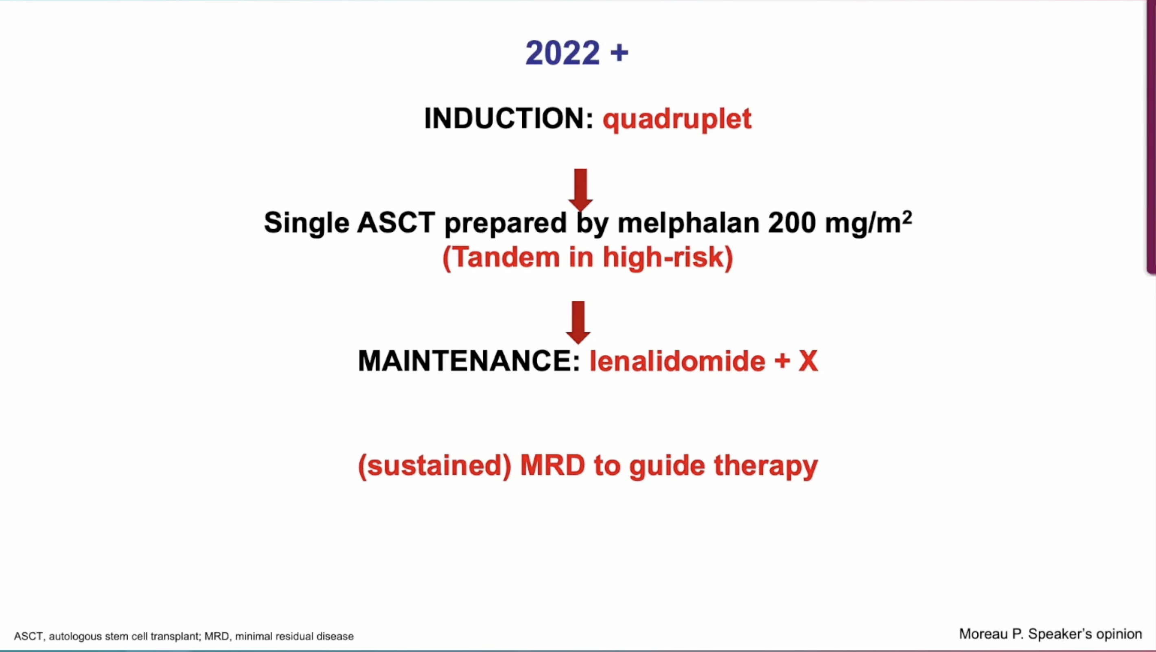

Slide 47
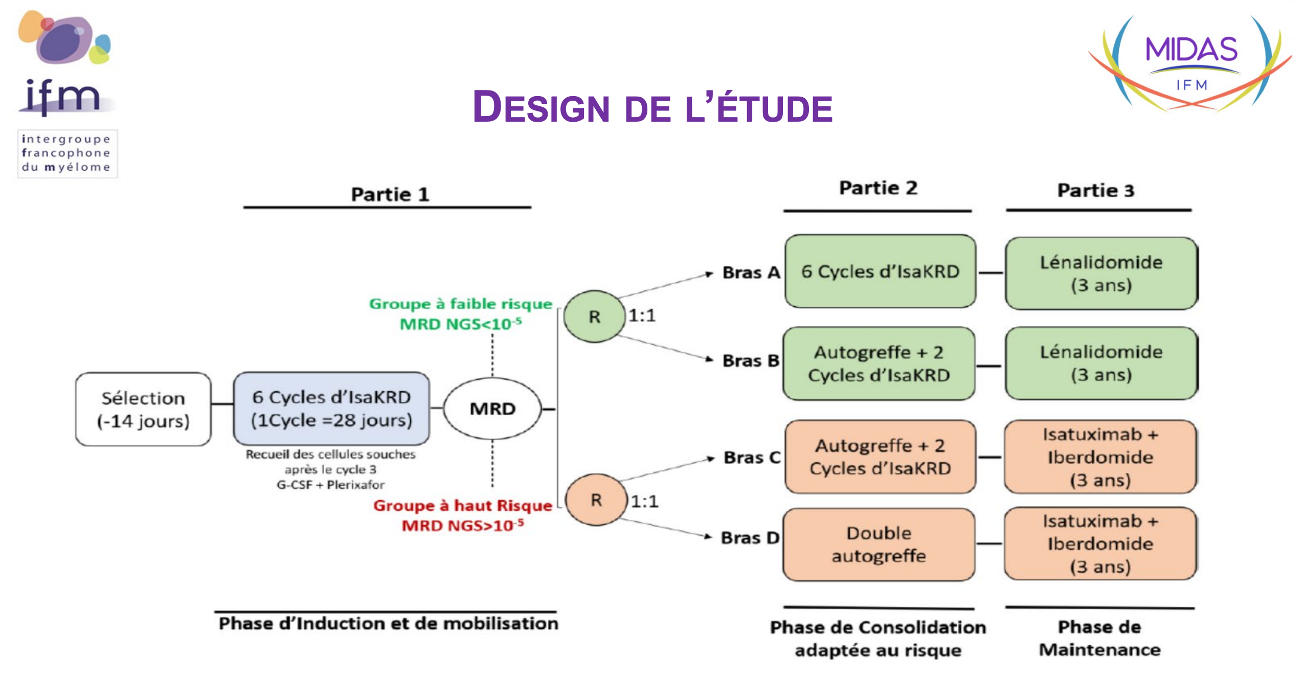

Slide 48
Traitement de première ligne

Slide 49
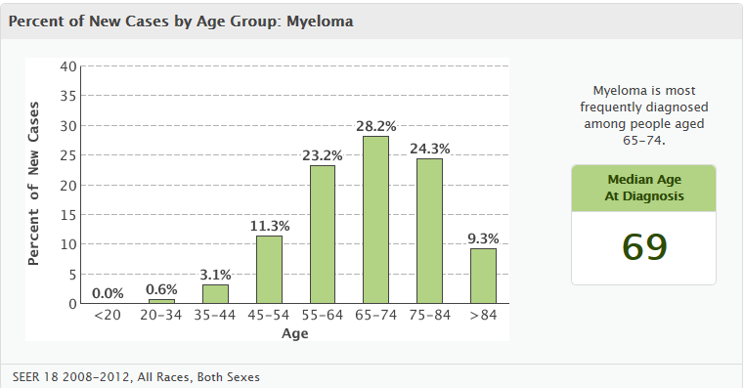
Myeloma and the very elderly
not so uncommon
33%
incidence in patients > 75y = 50/100.000/y
SEER database, accessed november 2015

Slide 50
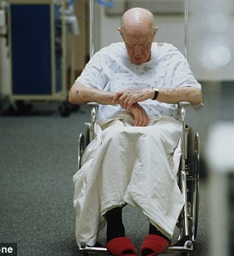

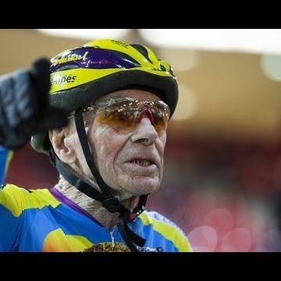
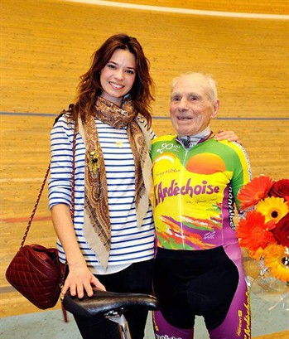
The heterogeneity of ageing
Notes:
Robert Marchand: 105 years

Slide 51
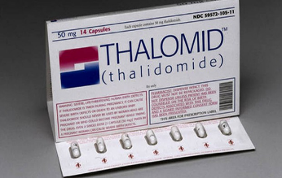
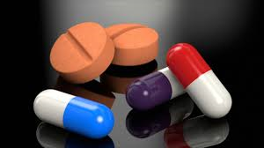
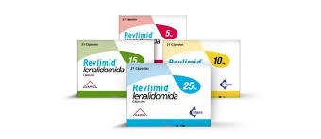
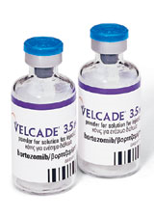
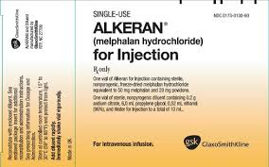
Traitement optimal
But: administrer un traitement efficace avec le moins de toxicité.
Risque de sous-traiter: rechute rapide
Risk of surtraitement: arrêt précoce du traitement
Efficacité
Toxicité

Slide 52
The IMWG frailty scoring system
Patients are categorized into 3 severity groups: fit, intermediate or frail
IMWG Frailty Scale¹ | Score
Age
≤ 75 yrs | 0
76–80 yrs | 1
> 80 yrs | 2
Activity of Daily Living score
> 4 | 0
≤ 4 | 1
Instrumental Activity of Daily Living score
> 5 | 0
≤ 5 | 1
Charlson Comorbidity Index score
≤ 1 | 0
≥ 2 | 1
 | 0: Fit
 | 1: Intermediate
 | ≥ 2: Frail
Total score:
IMWG, International Myeloma Working Group.
Palumbo A, et al. Blood. 2015;125:2068-74.

Slide 53
Phase III MAIA Trial: Survival With DaraRd vs Rd in Older or ASCT-Ineligible Patients
Median follow-up: 28 mos (range: 0.0-41.1)
P < .0001
100
D-Rd
Median:
not reached
30 mos
100
ORR: 93%
80
71%
ORR: 81%
80
30
≥ CR:
48%
≥ CR:
25%
12
60
56%
12
60
Rd
Median: 31.9 mos
17
PFS (%)
ORR (%)
40
40
28
≥ VGPR:
53%
32
≥ VGPR:
79%
20
HR: 0.56 (95% CI: 0.43-0.73;
P < .0001)
20
28
0
14
0
DaraRd
(n = 368)
Rd
(n = 369)
0
3
6
9
12
15
18
21
24
27
30
33
36
39
42
Mos
CR
sCR
Pts Risk, n
Rd
DaraRd
PR
VGPR
369
368
332
347
307
335
280
320
254
309
236
300
219
290
200
271
149
203
94
146
50
86
18
35
3
11
2
1
0
0
MRD negativity increased with addition of daratumumab
  DaraRD: 24% MRD negative
  Rd: 7% MRD negative
Daratumumab treatment favored in most subgroups analyzed, including age, race, ISS stages, ECOG PS scores
Reduced risk of progression or death with MRD negativity in both arms
Facon. ASH 2018. Abstr LBA-2.
Notes:
ECOG, Eastern Cooperative Oncology Group; ISS, International Staging System; MRD, measurable residual disease; NR, not reached; PS, performance status; Rd, lenalidomide/dexamethasone.

Slide 54
Proposed Drug Dosing by Frailty/Risk Score
Agent | Dose Level 0 (No Risk Factors) | Dose Level -1 (≥ 1 Risk Factor) | Dose Level -2 (≥ 1 Risk Factor + Grade 3/4 Nonheme AE)
Dexamethasone | 40 mg/day Days 1,8,15, 22/4 wks | 20 mg/day Days 1, 8, 15, 22/4 wks | 10 mg/day Days 1, 8, 15, 22/4 wks
Melphalan | 0.25 mg/kg or 9 mg/m² Days 1-4/4-6 wks | 0.18 mg/kg or 7.5 mg/m² Day 1-4/4-6 wks | 0.13 mg/kg or 5 mg/m² Day 1-4/4-6 wks
Thalidomide | 100 mg/day | 50 mg/day | 50 mg QOD
Lenalidomide | 25 mg/day Days 1-21/4 wks | 15 mg/day on Days 1-21/4 wks | 10 mg/day Days 1-21/4 wks
Pomalidomide | 4 mg/day Days 1-21/4 wks | Reduce dose to 3 mg/day or further due to hematologic toxicity, reduce dose by 50% with strong CYP1A2 inhibitor
Bortezomib | 1.3 mg/m² 2x/wk Days 1, 4, 8, 11/3 wks | 1.3 mg/m² 1x/wk Days 1, 8, 15, 22/5 wks | 1.0 mg/m² 1x/wk Days 1, 8, 15, 22/5 wks
Ixazomib | 4 mg/day Days 1, 8, 15/4 wks | First reduction: 3 mg Hold Tx if low blood counts or PN (resume at lower dose) | Second reduction: 2.3 mg/day; discontinue if grade 4 PN
Prednisone | 60 mg/m² Days 1-4 or 50 mg QD | 30 mg/m² Days 1-4 or 25 mg QD | 15 mg/m² Days 1-4 or 12.5 mg QD
Cyclophosphamide | 100 mg/day Days 1-21/4 wks or 300 mg/m²/day Days 1, 8, 15/4 wks | 50 mg/day Days 1-21/ 4 wks or 150 mg/m²/day Days 1, 8, 15/4 wks | 50 mg/day Days 1-21/4 wks or 75 mg/m²/day Days 1, 8, 15/4 wks
Palumbo A, et al. Blood. 2011;118:4519-4529. Palumbo A, et al. Blood. 2015;125:2068-2074.
Ixazomib [package insert]. Pomalidomide [package insert].
Notes:
AE, adverse event.

Slide 55
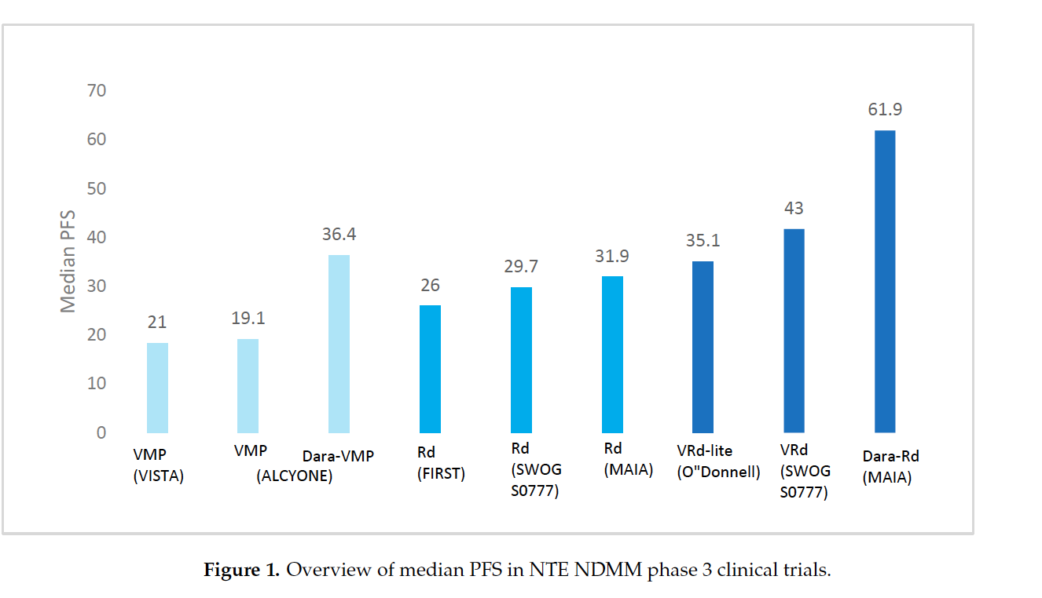
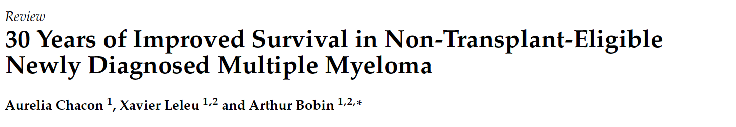
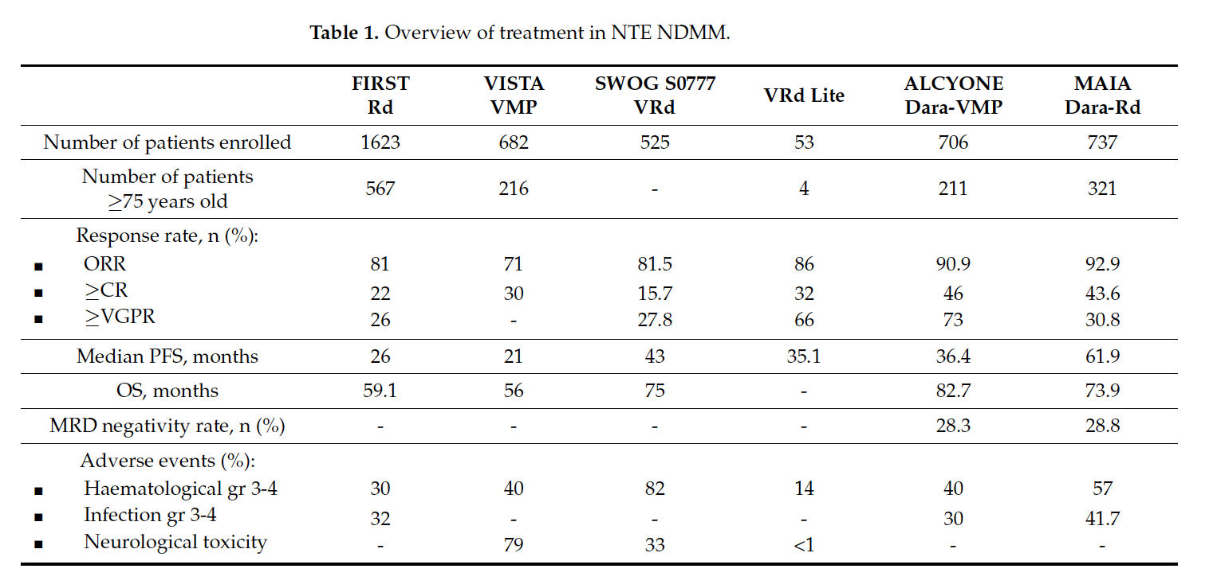
Cancers 2023;15:1929

Slide 57
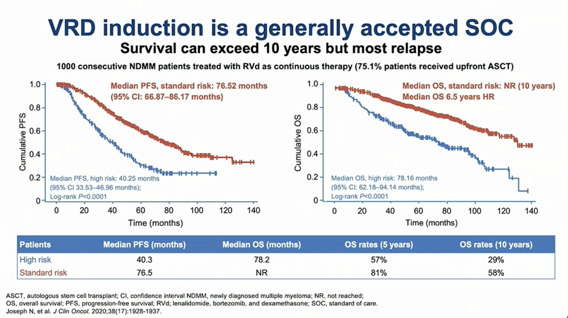
Myélome multiple: la rechute reste la règle

Slide 59

Coût de la prise en charge du myélome
Yong K I. MW 2021

Slide 60
Valeur nominale
Lénalidomide 1517 Eur / boite
Pomalidomide: 6360 Eur / boite
Bortezomib: 402 Eur
Carfilzomib: 1272 Eur / flacon 60 mg
Daratumumab 1800 mg : 5766 Eur

Slide 61

50-70% des patients avec RRMM aux USA ne sont pas incluables dans les essais cliniques de combinaisons approuvées ou recommandées

Slide 62

Ramasamy et al.
Blood Rev 2021 Sep;49:100808.

Slide 63

Traitement de deuxième ligne: recommandations
*
DKD
IsaKD non autorisés
IsaPomDex
PVD
KCD
PCD
KCD
EHA-ESMO guidelines 2021
Dimopoulos et al.
Hemasphere 2021

Slide 64
IMWG Study on Refractory Myeloma: Scope of the Problem
Survival From Time of PI and IMiD resistance
1.0
OS
PFS
0.8
0.6
Proportion of Patients
0.4
0.2
0
0
20
40
60
80
Mos
Kumar. Leukemia. 2017;31:2443.

Slide 65


Slide 66


YES WE CRY
IsaPomDex
KCD
Belantamab mafodotine

Slide 67

Patients penta-réfractaires
NEW NEW AGENTS
Selinexor
Belantamab-mafodotine
BITES et AC bispécifiques
Car T cells
Melflufen
Iberdomide
Venetoclax
Bendamustine
Panabinostat
VDT PACE
Alkeran / cyclophosphamide
Ramasamy et al. Blood Reviews 2021

Slide 69

Immunotherapeutic Approaches in MM

Slide 70

ADCC: antibody dependant cellular cytotoxicity
ADCP: antibody dependant cellular phagocytosis

Slide 71

1. Dimopoulos MA et al. Hemasphere 2021;5:2 (e528) 2. Lonial S et al. Lancet Oncol2020;21(2):207-221
3.Lonial S. et al. Cancer 2021
4. Lonial S et al. Society of Hematoloic Oncology Annual Meeting September 9-12 2020, poster MM-219

Slide 72



Lonial S et al. Cancer. 2021 Jul 27. doi: 10.1002/cncr.33809

Slide 73
Immunotherapeutic Approaches in MM

Slide 74

Antigènes de surface étudiés dans les essais cliniques myélome
Journal of Hematology and Oncology 2022;15:78

Slide 75


J. Clin. Med. 2021, 10(19), 4593;
https://doi.org/10.3390/jcm10194593
Le fragment Fc augmente la demi-vie
La taille du BITE permet une meilleure pénétration tissulaire

Slide 76


Am J Hematol 2023;98:S13-S21

Slide 77

Teclistamab
Novel BCMA × CD3 T-Cell Redirecting Bispecific Antibody

Slide 78

Talquetamab Mode of Action
GPRC5D × CD3 Bispecific Antibody

Slide 79

MajesTEC-1
Overall Response to Teclistamab

Slide 80

MajesTEC-1 Cohort C
ORR

Slide 81


MajesTEC-1
PFS
Moreau P et al. N Engl J Med2022;387:495-505
Moreau P et al. N Engl J Med2022;387:495-505

Slide 82

MajesTEC-3: Phase 3 Study of Tec + Dara vs DPd or DVd in Patients With R/R MM

Slide 83

MajesTEC-1
Safety Profile

Slide 84

Bispecific Antibodies
AEs

Slide 85

Grading Criteria for CRS

Slide 86

Step-Up Doses to Mitigate the Risk of CRS
Bispecific Antibodies

Slide 87
AC bispécifiques: quelques considérations.
Activité augmentée par les IMIDs
  Essais cliniques en cours
Fonction lymphocytaire T meilleure dans premières lignes de traitement.
  Essais cliniques en première ligne et dans rechutes précoces
Action inhibée par les lymphocytes T régulateurs
  Combinaison avec le daratumumab
Toxicité
  CRS
  Atteinte neurologique

Slide 88
Immunotherapeutic Approaches in MM

Slide 90

Processus de fabrication CAR T cell
Front Immunol 2022;13:991092

Slide 91

Mode d’action CAR T cell
Front Immunol 2022;13:991092

Slide 92


Cancers 2023;15:1929

Slide 93

Front Immunol 2022;13:991092

Slide 94

CRS With BCMA-Targeted CAR T-Cell Therapy

Slide 95

Immune-Cell Associated Neurotoxicity Syndrome
Overview

Slide 96

Mechanisms Underpinning ICANS

Slide 97

Timing of ICANS Onset

Slide 98

Symptoms of ICANS

Slide 99

Assessment of ICANS

Slide 100

Grading and Management of ICANS
Expert Recommendations

Slide 101

Approved CAR T-Cell Therapies

Slide 102

BCMA CAR T-Cell Therapy in a Heavily Pretreated Population
AEs

Slide 103

BCMA CAR T-Cell Therapy in a Heavily Pretreated Population
AEs

Slide 104

BCMA CAR T-Cell Therapy in a Heavily Pretreated Population
AEs

Slide 105
Comparaison BITE et CART
 |  | CAR T cells | Anticorps bispécifiques
Efficacité | >/ PR >/ CR | 70-97% 30-80% | 70% 30-39%
Sécurité | CRS Neurotoxicité | 65-95% >/ Grade 3: 3-5% 13-21% >/ grade 3: 3-10% | 39-77% >/ grade 3: 0-9% Premières injections 0-20% >/ grade 3: 0-1%
Blood Cancer Discovery July 2021

Slide 106
Comparaison BITE et CART
Disponibilité | Ide-cells approuvé FDA Cilta-cells approuvé FDA | Teclistamab approuvé FDA et EMEA
Nombre d’administrations | 1 | Jusque progression
Hospitalisation | Oui | Souvent requise au début
Voie d’administration | IV | SC
Infrastructure | Requiert une structure spécialisée | Peut être administré dans la majorité des hôpitaux si USI
Disponible facilement | Non | Oui
 | Complique le traitement d’un patient avec maladie rapidement progressive
Blood Cancer Discovery July 2021

Slide 107
Conclusion:
Les « nouvelles drogues » sont arrivées en première ligne
  Triplets / quadruplets
  PFS /OS plus longue mais rechutes plus agressives (PCL, EMD, …)
Les patients des études cliniques sont sélectionnés.
Les études cliniques sont limitées à certains centres.
Combler le fossé entre réalité des essais et la réalité au lit du patient.
L’efficacité de l’immunothérapie est compromise par la diminution de l’immunité.
Délai entre l’enregistrement du médicament et sa disponibilité.
Meilleurs outils prédictifs pour administrer la combinaison la plus adéquate au bon moment au bon patient pour la durée optimale (MRD).
Le coût des médicaments devient une grosse limitation.

Slide 108


